Slide 1
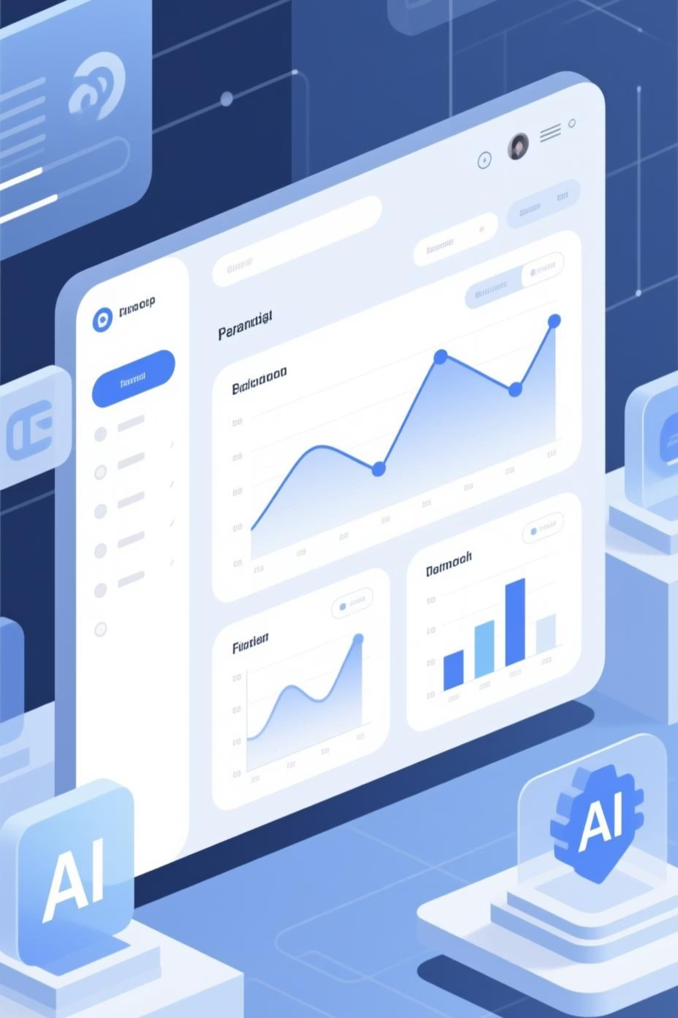
InvestorIQ
Smarter Investment Discovery Through AI
An intelligent platform that goes beyond traditional sector classifications to understand what companies actually do, powered by semantic AI and real-time data analysis.
Team M(AI)L

Slide 2

The Problem with Traditional Tools
Static Classification Systems
Bloomberg, Yahoo Finance, and GICS-based platforms classify companies into rigid, single-industry buckets. Tesla is "automotive," Microsoft is "software" — missing their robotics, quantum computing, and cross-sector innovations entirely.
Investors relying on these tools miss hidden opportunities and emerging market leaders operating across multiple domains.

Slide 3

Our Solution: Semantic Intelligence
AI-Powered Understanding
Conversational Discovery
Cross-Sector Insights
Ask questions naturally: "Show quantum computing leaders" or "Who's investing in renewable infrastructure?" Get intelligent, context-aware responses.
Discover companies operating across multiple industries — like Tesla in robotics or Microsoft in cloud AI infrastructure.
InvestorIQ analyzes what companies actually do, not just their official sector labels, using advanced semantic processing and embeddings.

Slide 4

Platform Capabilities
1
Semantic Company Database
2
Intelligent Search & Chat
3
Thematic Portfolio Builder
Powered by Ollama GPT, users can explore investments conversationally, receiving real-time recommendations backed by actual company data and embeddings.
Create custom watchlists around investment themes — AI infrastructure, clean energy, biotech innovation — and track aggregated insights across your selections.
Enriched company profiles with AI-generated summaries, industry tags, investment themes, and material points drawn from comprehensive data analysis.

Slide 5
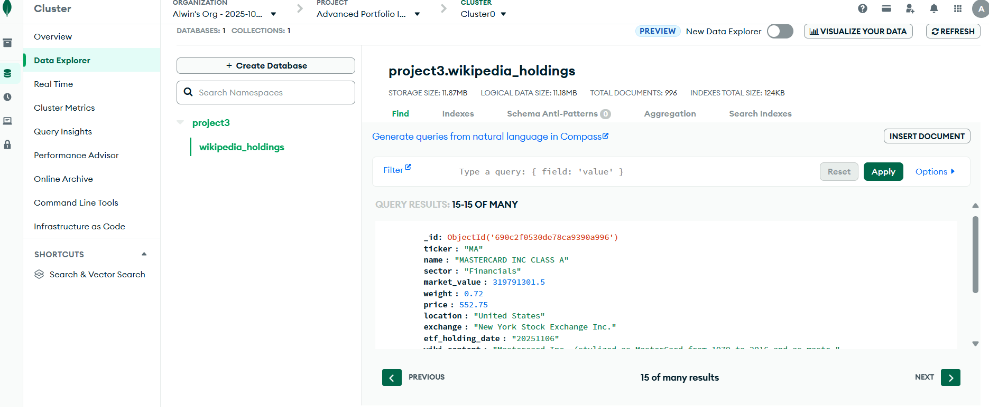
MongoDB Database

Slide 6
Technical Architecture
Data Layer
AI Layer
MongoDB database
Ollama (gpt-oss model)
wikipedia_holdings collection
Semantic retrieval engine
Semantic embeddings storage
Context-aware responses
Real-time data pipeline
Automatic ticker extraction

Slide 7
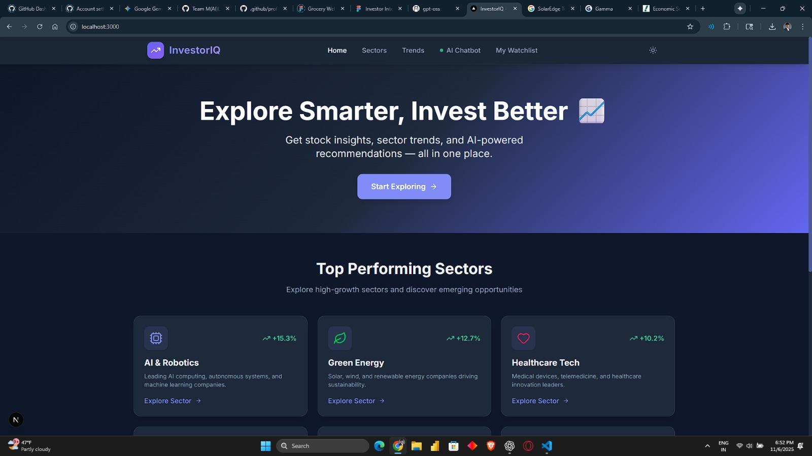

Slide 8
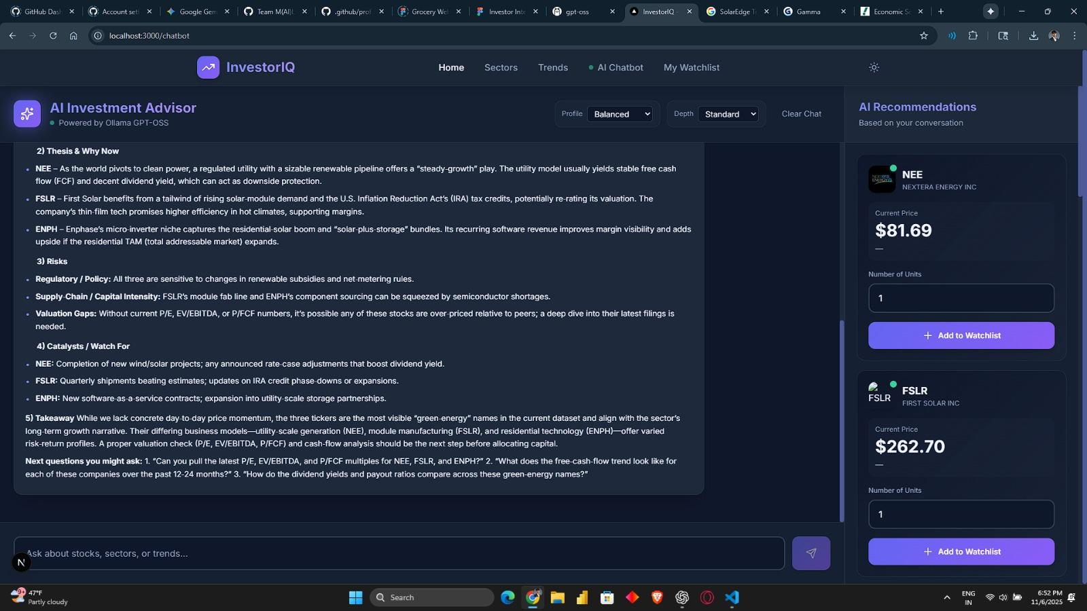

Slide 9
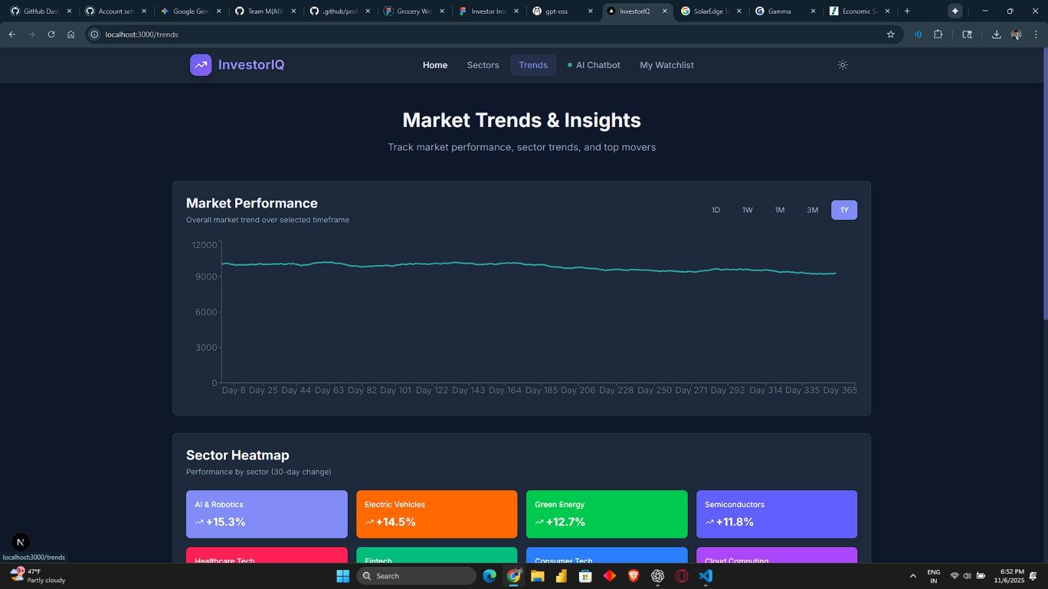

Slide 10
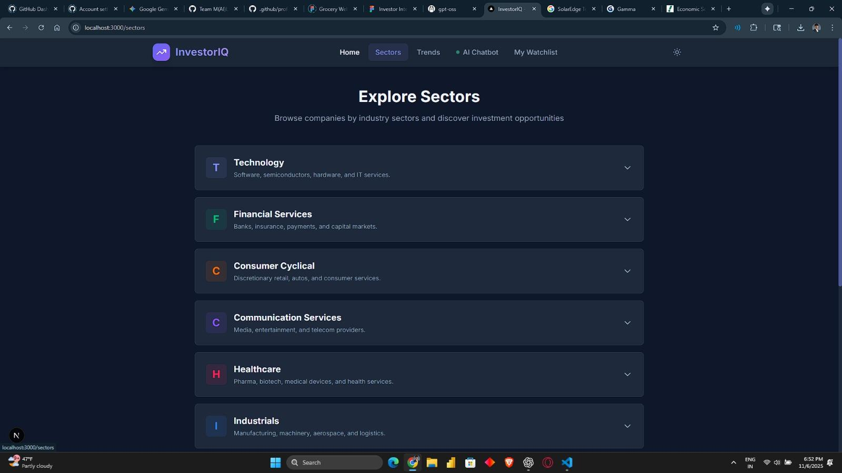

Slide 11




User Experience Flow
Explore Dashboard
Ask & Discover
Build Portfolio
Browse all companies with summaries, tickers, categories, and logos displayed in clean, scannable cards.
Use conversational AI to explore: "Who leads in AI infrastructure?" Get relevant companies instantly.
Add companies to thematic watchlists and view aggregated insights across your selections.

Slide 12

AI-Powered Query Examples
"Show me companies working on quantum computing infrastructure"
"Who are the key players in renewable energy storage and distribution?"
"Add Nvidia, Tesla, and Microsoft to my AI innovation portfolio"
The chatbot intelligently retrieves company data from MongoDB, analyzes semantic embeddings, and provides context-aware recommendations with automatic ticker extraction and portfolio management capabilities.

Slide 13

Competitive Advantage
GICS Systems
Dynamic multi-dimensional classification capturing real business activities versus static single-sector labels.
vs. Bloomberg Terminal
More intuitive conversational interface, semantic discovery instead of complex queries, accessible pricing model.
vs. Yahoo Finance
AI-driven insights beyond basic fundamentals, cross-sector activity mapping, thematic portfolio intelligence.

Slide 14

Delivering Professional Intelligence
For Investors
For Analysts
Discover hidden opportunities, understand cross-sector exposure, build thematic portfolios based on real company activities rather than outdated classifications.
Access semantic intelligence that reveals competitive landscapes, emerging players, and strategic positioning across multiple industries simultaneously.
For Portfolio Managers
Construct sophisticated thematic strategies using AI-powered research that connects companies through actual business operations and market innovations.

Slide 15
THANK YOU

